Slide 1
Course : Digital Communication Code : UEC-639 Semester : 5th Credit : 4.5
Branch : ENC

Slide 2
Course Objectives
The aim of this course is to build the foundation for communication system design focusing on the challenges of digital communication.
The intended objective is to impart knowledge to the engineering students about the transmission/reception of data over physical layer through any channel.
They will be able to identify the physical interpretation of mathematical expressions/modelling, while dealing with communication systems in the presence of noise, interference and fading.

Slide 3
Course Learning Outcomes
Upon completion of this course, the students will be able to:
1. Evaluate different modulation techniques in the presence of AWGN working under the various capacity constraints.
2. Incorporate digital formats and M-ary baseband modulations to improve bandwidth efficiency.
3. Perform statistical analysis of the transmitted and received modulated waveforms from estimation and detection point of view.
4. Improve the overall performance of digital communication systems by interference suppression/ excision and by implementing the signal-to-noise-ratio enhancement techniques.
5. Analyze the concepts of correlative coding and channel coding to mitigate the effects of interference and noise in the channel.

Slide 4
Course Contents
Unit-1: Introduction to Pulse Modulation Systems
Unit-2: Digital Formats and Baseband Shaping for Data Transmission
Unit-3: Fundamentals of Detection and Estimation
Unit-4 Digital Modulation Schemes With & Without Memory
Unit-5 Coding Aspects
Unit-6 Multiple Access Techniques

Slide 5
Unit-1
Introduction to Pulse Modulation Systems:
Basic model of digital communication system,
Bandpass and lowpass signal and system representations,
lowpass equivalent of bandpass signals,
Sampling theorem for baseband and bandpass signals,
quantization, Companding,
signal reconstruction filter,
Shannon-Hartley channel capacity theorem,
Bandwidth – SNR tradeoff and bounds,
Difference between analog pulse modulation and digital pulse modulation techniques,
Details about PCM, Differential-PCM, DM, Adaptive-DM, time-division-multiplexed system (T- & E-type),
and output SNR calculations

Slide 6
Unit-2
Digital Formats and Baseband Shaping for Data Transmission:
NRZ, RZ, and Manchester formats,
Power spectra of discrete-PAM signals,
ISI,
Nyquist’s criterion for distortion-less baseband transmission with ideal and practical solutions,
generalized correlative coding and its types,
and eye pattern

Slide 7
Unit-3
Fundamentals of Detection and Estimation:
Gram-Schmidt orthogonalization procedure,
MAP criterion,
maximum likelihood (ML) decision rule,
Correlator receiver,
Matched filter receiver,
ML estimation procedure,
probability of bit-error & symbol-error calculations for digital modulation techniques under AWGN channel,
and union bound on probability of error

Slide 8
Unit-4
Digital Modulation Schemes With & Without Memory:
Details about Binary-ASK, BFSK, BPSK, QPSK,
M-ary ASK, M-ary FSK, M-ary PSK, M-ary QAM;
MSK,
generalized continuous-phase-FSK;
Differential-PSK,
phase-locked-loop, and carrier recovery procedures

Slide 9
Unit-5 and 6
Coding Aspects:
Block-code generation,
its types and decoding procedures,
convolutional code generation,
its types and Viterbi decoding procedure,
error detection and correction concepts in decoding
Multiple Access Techniques:
Brief introduction about
TDMA, FDMA, WDMA, CDMA, and OFDM systems

Slide 10
Experiments
Practical/experiments based on the hardware using communication kits,
simulation with the help of available simulation packages (Like MATLAB)

Slide 11
Text Books
Simon Haykin, Digital Communications, Wiley.
John G. Proakis, Digital Communications, McGraw-Hill, Third Edition.
Bernard Sklar, Digital Communications: Fundamentals and Applications, Prentice Hall

Slide 12
Reference Books
Taub & Schilling, Principles of Communication Systems, McGraw-Hill Publications, Second Edition.
Simon Haykin, Communication Systems, Wiley, Fourth Edition.
B.P. Lathi, Modern Analog and Digital Communication Systems, Oxford University Press, Third Edition.

Slide 13
Digital Communication
What is communication ?
Difference between digital and analog communication
Why digital ?
Block diagram of Digital Communication system

Slide 14
What is communication ?

Slide 15
Communication
Main purpose of communication is to transfer information from a source to a recipient via a channel or medium.
Basic block diagram of a communication system:
Source
Transmitter
Channel
Receiver
Recipient

Slide 17
Brief Description
Source: analog or digital
Transmitter: transducer, amplifier, modulator, oscillator, power amp., antenna
Channel: e.g. cable, optical fibre, free space
Receiver: antenna, amplifier, demodulator, oscillator, power amplifier, transducer
Recipient: e.g. person, (loud) speaker, computer

Slide 19
Types of communication systems
Public Switched Telephone Network (voice, fax, modem)
Satellite systems
Radio, TV broadcasting
Cellular phones
Computer networks (LANs, WANs, WLANs)

Slide 20
Why Digital ?

Slide 22
Easy to mix signals and data using digital techniques
Can combine different signal types – data, voice, text, image, video etc.
Data communication in computers is digital in nature whereas voice communication between people is analog in nature
The two types of communication are difficult to combine over the same medium in the analog domain.
Using digital techniques, it is possible to combine both format for transmission through a common medium

Slide 23
Encryption and privacy techniques are easier to implement
Better overall performance
Digital communication is inherently more efficient than analog in realizing the exchange of SNR for bandwidth
Digital signals can be coded to yield extremely low rates and high fidelity as well as privacy.

Slide 24
Hardware is more flexible
Digital hardware implementation is flexible and permits the use of microprocessors, mini-processors, digital switching and VLSI
Shorter design and production cycle
Low cost
The use of LSI and VLSI in the design of components and systems have resulted in lower cost
Easier and more efficient to multiplex several digital signals
Easier and more efficient Multiple Access Technique like TDMA, FDMA, CDMA etc.

Slide 25
Challenges in Digital Communications
Requires reliable “synchronization”
Requires A/D conversions at high rate
Requires larger bandwidth

Slide 26
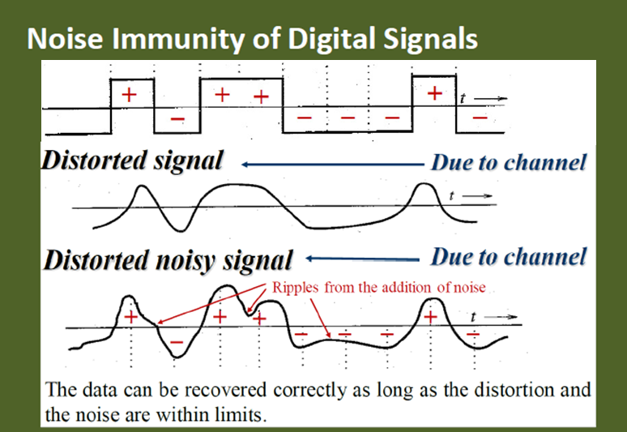

Slide 29
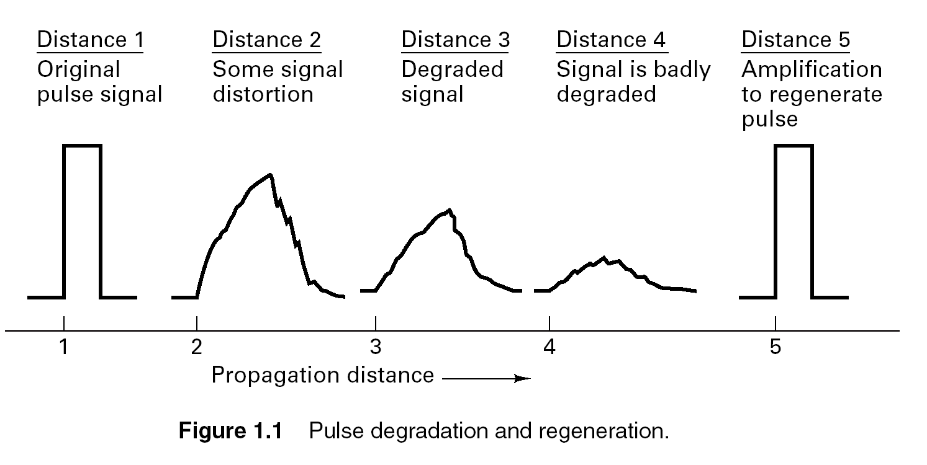

Slide 31
Complete Block Diagram of Digital Communication System

Slide 32
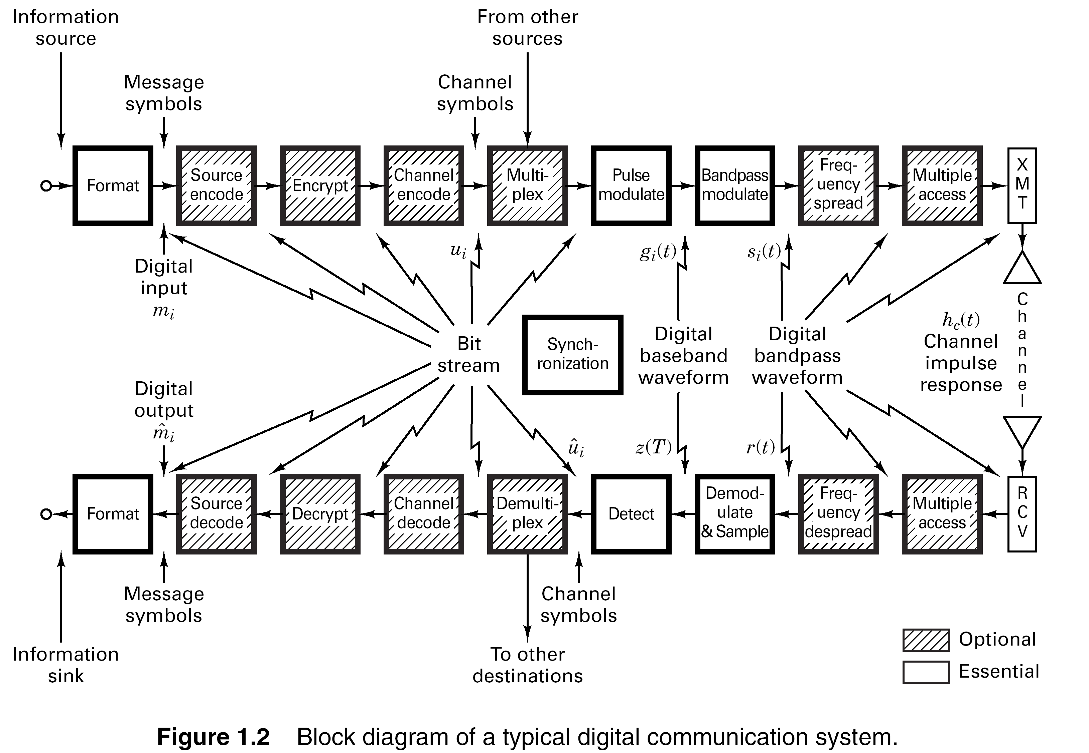

Slide 33
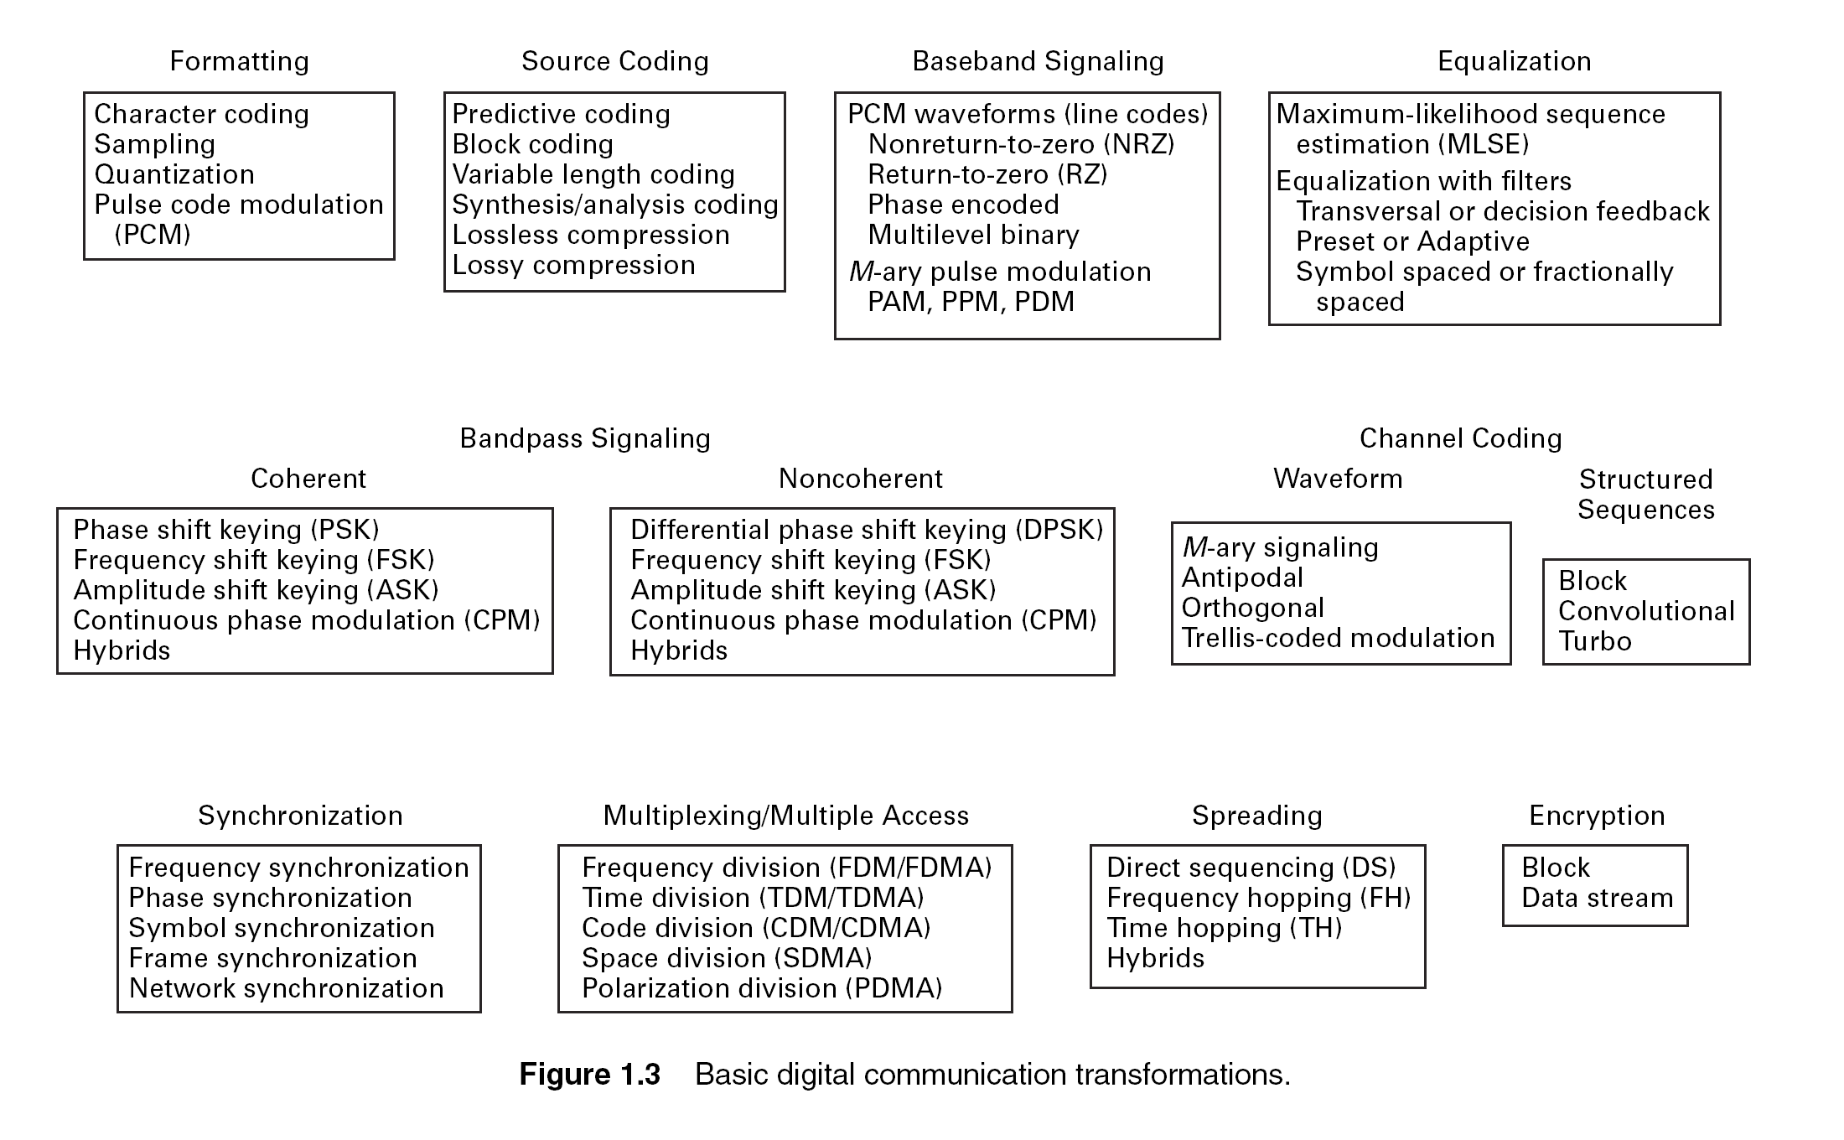

Slide 34
Performance Metrics
Analog Communication Systems
Metric is fidelity: want
SNR typically used as performance metric
Digital Communication Systems
Metrics are data rate (R bps) and probability of bit error (BER)
Symbols already known at the receiver
Without noise/distortion/sync. problem, we will never make bit errors

Slide 35
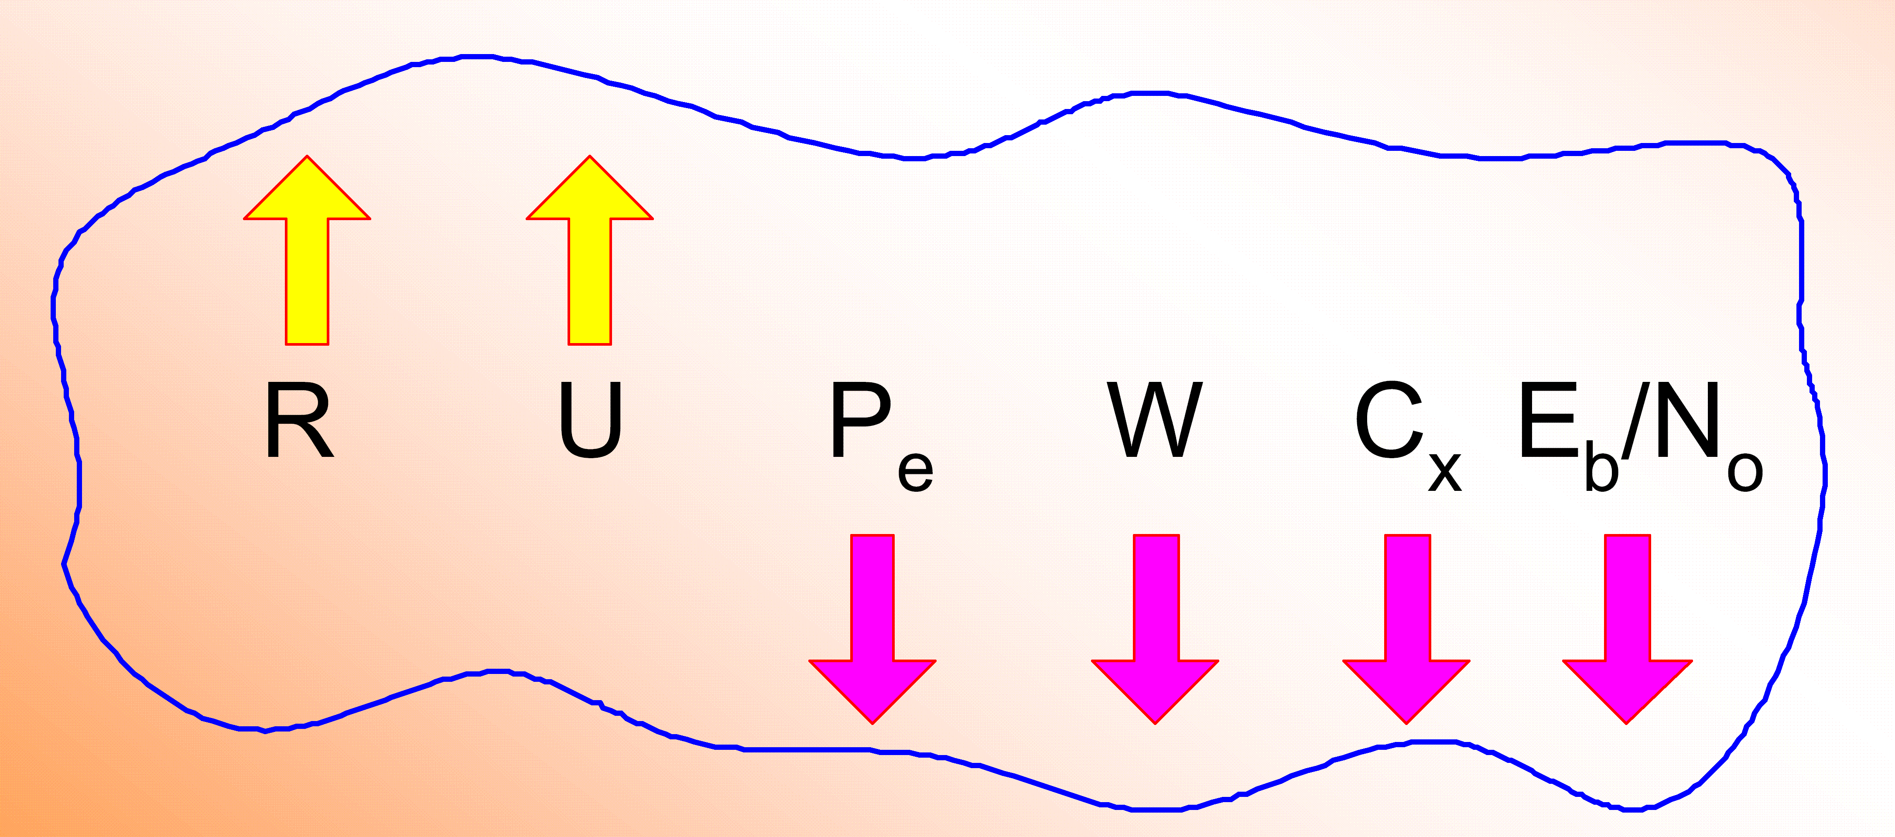
Goals in Communication System Design
To maximize transmission rate, R
To maximize system utilization, U
To minimize bit error rate, P_{e}
To minimize required systems bandwidth, W
To minimize system complexity, C_{x}
To minimize required power, E_{b}/N_{o}

Slide 36
Thanks !

